Slide 1
Grad School Applications Preparations 101

Slide 2
Why are you interested in Grad School?
Let’s hear from you!

Slide 3
Myth about Grad School
Grade myths (You do not need all As)
School myth (You do not need to “must” go to IVY league )
Test (GRE, MCAT, LSAT) myth (you don’t need to practice or take these in freshman or sophomore year)
Year myth (you do not have to go to grad school directly from UG)
Peer pressure myth (you do not have to go to grad school just because your peers are going)
Timeline myth (you do not need to start application process as early as possible)

Slide 4
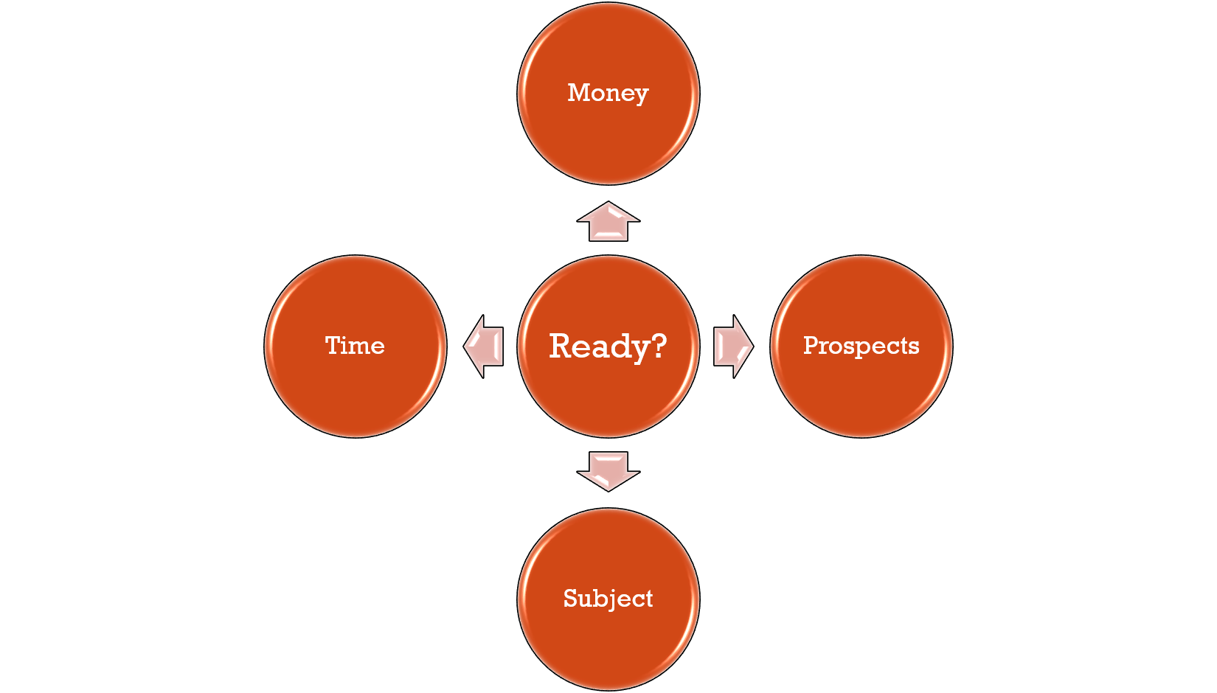
Ask yourself “Are you ready for Graduate School?”
Am I financially prepared?
How much time do I need to apply?
What are my prospects after grad school?
Do I know what I want to study?

Slide 5
Typical timeline of the application process
Year 1 @ DKU
Year 2 @ DKU
•Become familiar with DKU campus resources and services
•Meet with an academic advisor
•Drop-in at the Career Services
•Explore research opportunities with faculty
•Get involved in extracurricular activities (e.g. volunteering, clubs and organizations, field trips…)
•Choose/Declare an interest/major
•Meet with your academic advisor and career services coaches
•Apply for/participate in research opportunities on/off campus
•Explore options for participating in experiential learning opportunities (e.g. internships, externships, & job shadowing)

Slide 6
Typical timeline of the application process
Year 3 @ DKU
Year 4 @ DKU
•Research and identify graduate programs/schools and become familiar with the application process for each school of interest.
•Discuss prospective graduate programs with your faculty
•Prepare for/take graduate school admissions standardized tests
•Foster relationships as references for use in applications
•Explore graduate school funding options
•Begin crafting your personal statements/resume/CV
•Finalize the list of grad programs/schools to which you will apply.
•If you have not already, take your graduate admissions standardized tests
•Reach out to potential reference contacts (e.g. faculty, supervisor, etc…)
•Prepare and submit all the application materials
•And wait……

Slide 7
Monthly Timeline of Year 4 at DKU
Summer of 3rd year
September
October
•Finalize the list of grad programs/schools to which you will apply.
•Take standardized tests required by schools, if you have not.
•Request information from schools that interest you. Consider a campus visit.
•Begin drafting your statement of purpose.
•Contact your recommenders.
•Keep polishing your statement of purpose.
•Request official transcripts from your undergraduate institution.
•Send your recommenders supplemental materials (like your resume, personal statement, etc.)
• Filling up application

Slide 8
Monthly Timeline of Year 4 at DKU
Customize your own timeline
November
December
• Continue filling up application
• Continue polishing your statement of purpose
• Complete and submit grad applications, keeping copies of every section for your records.
• Verify that your recommendations have been sent.

Slide 9
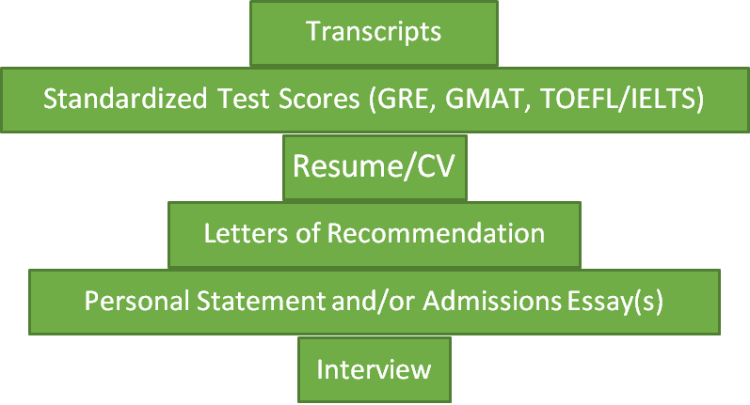
Basic Components
Read through the requirements of the Grad School you interested in.

Slide 10
Researching about Grad Schools
Simply ASK:
Professors at the school you are interested in
Professors from DKU, especially grad level professors
Your academic advisor
Students of the school you are interested in :
Linkedin
Official website
Alumni with your desired degree

Slide 11


Researching about Grad Schools
https://www.kaptest.com/study/gre/the-grad-school-application-guide/#best

Slide 12
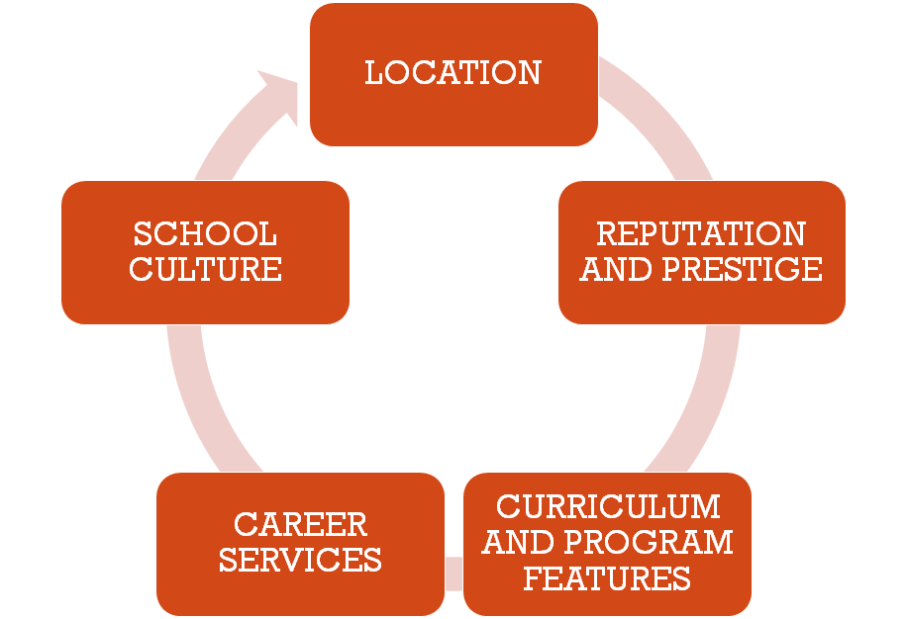
Researching about Grad Schools

Slide 13
Researching about Grad Schools

Slide 14
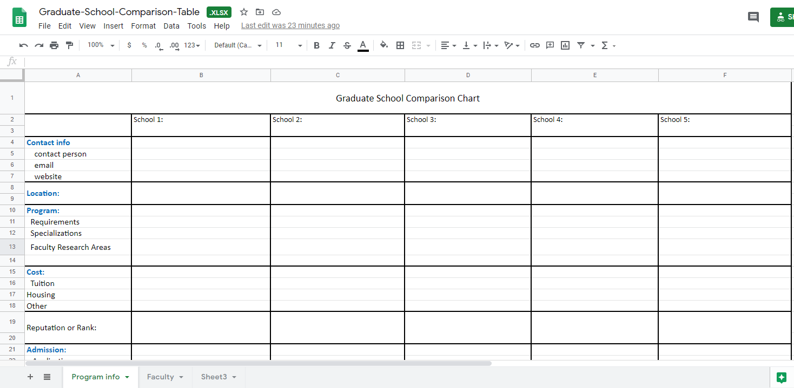
Build your Grad School list

Slide 15
Exam Resources

Slide 16
Informational Interview
Who do you think you could talk to?
Informational Interview Strategies?
Attend Grad school info session held by career services
Professors at the school you are interested in
Professors from DKU, especially grad level professors
Your academic advisor
Students of the school you are interested in
Alumni with your desired degree
Workshop held by career services about how to conduct informational interview.

